Slide 1

Analysis of Variance (ANOVA)
ANOVA Simultaneous Component Analysis (ASCA)
Age K. Smilde, Johan Westerhuis, Huub Hoefsloot
Swammerdam Institute for Life Sciences, University of Amsterdam

Slide 2
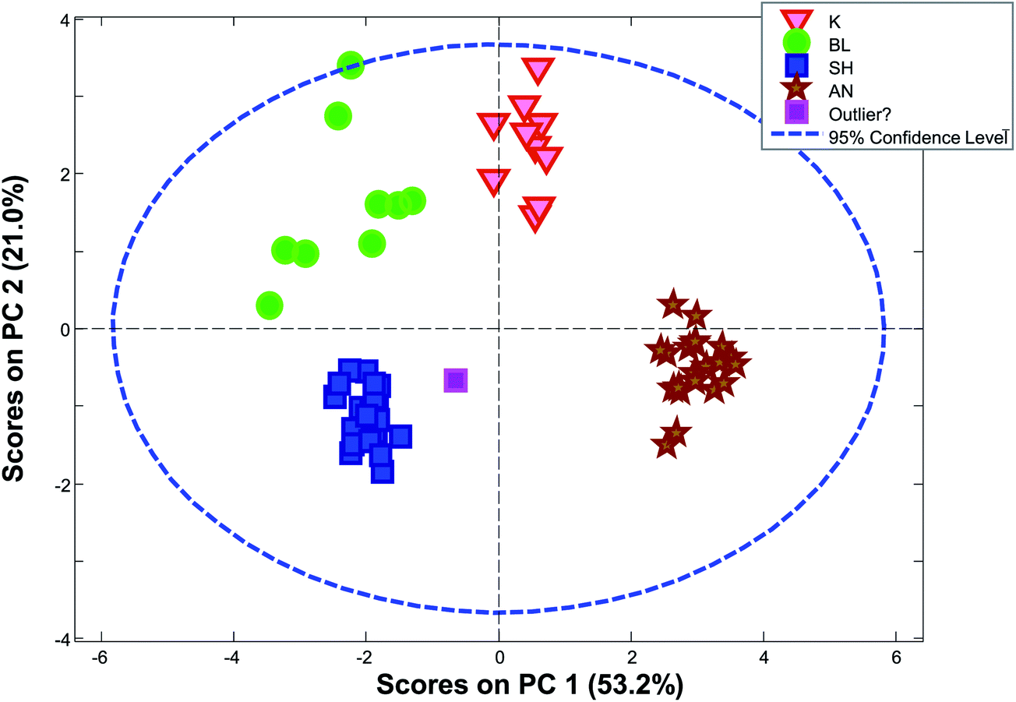
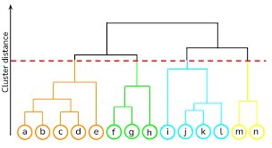
Methods
Exploration (X)
  PCA
  Clustering
  Y information is not used in calculations, but only to color samples
Supervised analysis
  Use Y to calculate model (Y = Xb + E)
  Classification: Y defines groups
  High dimensional ANOVA: Y defines experimental design information
  Regression: Y defines quantitative information
Machine learning for nonlinear models
  Random Forest
  Neural Nets
Validation:
  Test whether model does not overfit / effects are different from zero
Variable (metabolites / genes)
Response (Y)
Data (X)
Samples
Univariate analysis (Gene expression data)
  Comparability
  Error structure
Multivariate data analysis methods
  Gene expression and metabolomics data
Microbiome data
  Sparse and compositional data requires specific multivariate data analysis tools based on between sample distances

Slide 3
Goals:
Intro to ANOVA (Analysis of Variance)
Understand relationship ANOVA and linear model
Combine ANOVA (Linear model) and PCA for high-dimensional data
  Explore multivariate treatment effect
  Validation

Slide 4
ANOVA vs Linear model
ANOVA uses group means to calculate effect of factor levels
Linear model calculates effects by minimization of residuals over all levels simultaneously
  Equal to ANOVA for balanced data
  Better than ANOVA for unbalanced data
ASCA: ANOVA for many variables + PCA
ASCA+: Linear model for many variables + PCA

Slide 5
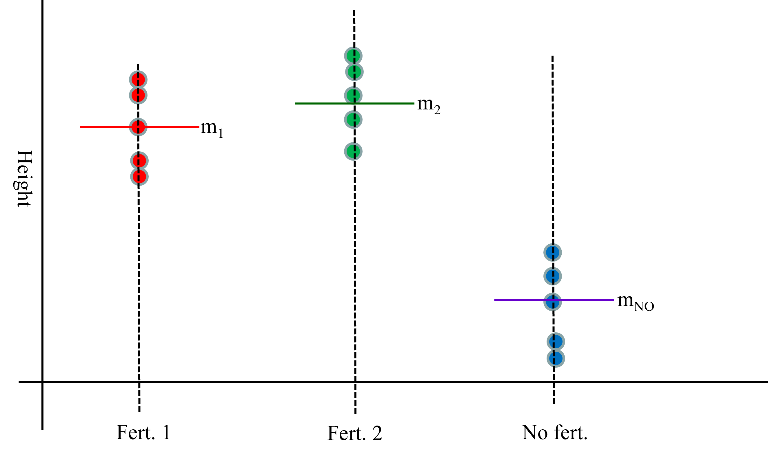
ANOVA
When do we use ANOVA?
  Look for differences between groups
  Test the effect of a treatment
What are the assumptions?
  Replicates in a group are normally distributed
  The variances within groups are equal
  Because F-distribution is used to determine significance
  If assumption are NOT met:
    Kruskal Wallace test (one-way ANOVA on ranks)

Slide 6
ANOVA: idea
m₂
m₁
Height
m_{NO}
Fert. 1
Fert. 2
No fert.
Is the difference between m₁, m₂ and m_{NO} large enough relative to within spread?

Slide 7
ANOVA: Assumption on equal variances
m₂
m₁
Height
m_{NO}
Fert. 1
Fert. 2
No fert.
No equal variances

Slide 8
ANOVA: Assumption of normality
m₂
m_{NO}
m₁
Height
Fert. 1
Fert. 2
No fert.
Not normally distributed (skewed). Sometimes: log transform

Slide 9
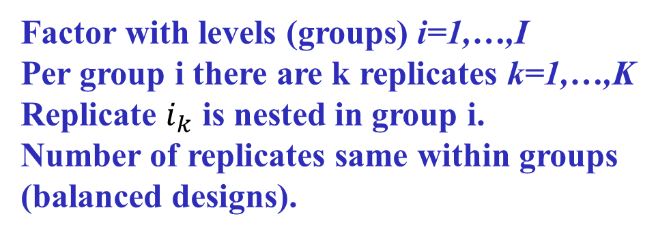
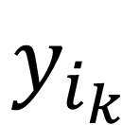
One-way ANOVA: notation
$$y_{i_{k}}$$
Factor with levels (groups) i=1,…,I
Per group i there are k replicates k=1,…,K
Replicate $i_{k}$ is nested in group i.
Number of replicates same within groups
(balanced designs).

Slide 10
One-way ANOVA: model
Assumptions!!
$$y_{i_{k}}=μ+α_{i}+ε_{i_{k}};ε_{i_{k}}\sim N\left(0,σ^{2}\right)$$
µ = overall mean
α_{i} = effect of factor (level i):
deviations relative to µ
Thus Ʃ α_{i}=0

Slide 11


One-way ANOVA: estimates
Between
group
individual,
Within group
Similar to LDA
Separation of between Covariance
and within Covariance
mean
$$y_{i_{k}}=y_{..}+\left(y_{i.}−y_{..}\right)+\left(y_{i_{k}}−y_{i.}\right)$$
$$y_{..}=\frac{\sum_{i=1}^{I}{\sum_{k=1}^{K}{y_{i_{k}}}}}{IK}$$
$$y_{i.}=\frac{\sum_{k=1}^{K}{y_{i_{k}}}}{K}$$
Notes:
Make comparison with LDA

Slide 12
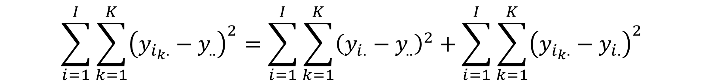
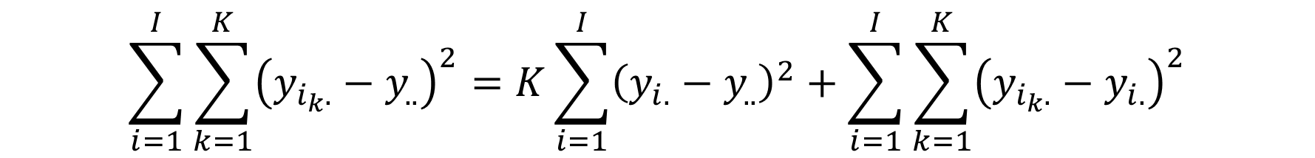
ANOVA: sums of squares (SS)
Total SS = Between group SS + Within group SS
$$\sum_{i=1}^{I}{\sum_{k=1}^{K}{{\left(y_{i_{k}.}−y_{..}\right)}^{2}}=\sum_{i=1}^{I}{\sum_{k=1}^{K}{{\left(y_{i.}−y_{..}\right)}^{2}}}+\sum_{i=1}^{I}{\sum_{k=1}^{K}{{\left(y_{i_{k}.}−y_{i.}\right)}^{2}}}}$$
$$\sum_{i=1}^{I}{\sum_{k=1}^{K}{{\left(y_{i_{k}.}−y_{..}\right)}^{2}}=K\sum_{i=1}^{I}{{\left(y_{i.}−y_{..}\right)}^{2}}+\sum_{i=1}^{I}{\sum_{k=1}^{K}{{\left(y_{i_{k}.}−y_{i.}\right)}^{2}}}}$$
Cross-products are 0 because of orthogonality of the design

Slide 13

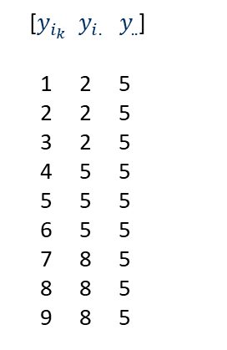
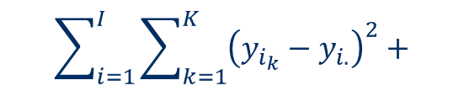


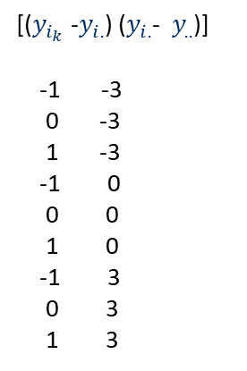
ANOVA – Sums of squares (SS)
Total SS = Between group SS + Within group SS + Cross product
$$2\sum_{i=1}^{I}{\sum_{k=1}^{K}{\left(y_{i_{k}}−y_{i.}\right)\left(y_{i.}−y_{..}\right)}}$$
$$\sum_{i=1}^{I}{\sum_{k=1}^{K}{{\left(y_{i_{k}}−y_{..}\right)}^{2}}}=$$
$$\sum_{i=1}^{I}{\sum_{k=1}^{K}{{\left(y_{i_{k}}−y_{i.}\right)}^{2}}}+$$
$$\sum_{i=1}^{I}{\sum_{k=1}^{K}{{\left(y_{i.}−y_{..}\right)}^{2}}}+$$
[$y_{i_{k}}{ y}_{i.}{ y}_{..}$]
1 2 5
2 2 5
3 2 5
4 5 5
5 5 5
6 5 5
7 8 5
8 8 5
9 8 5
[($y_{i_{k}}$-$y_{i.}$) ($y_{i.}$-${ y}_{..}$)]
-1 -3
0 -3
1 -3
-1 0
0 0
1 0
-1 3
0 3
1 3
Balanced
In balanced situation cross-products are 0.
Centered * constant = 0

Slide 14
ANOVA with design factor
Between
groups
Within
groups
Y - mean
=
Y_{α}
+
E (=Y-Y_{α})
-0.3224
-0.3126
-0.1440
0.0419
0.2656
0.4705
-0.6815
-0.5024
-0.2711
0.2018
-0.3532
1.6066
-0.2439
-0.4670
0.1257
0.0218
0.3772
0.1859
-0.6411
-0.5915
-0.0762
-0.3469
1.6143
0.0414
Time
1
1
1
1
1
1
2
2
2
2
2
2
3
3
3
3
3
3
4
4
4
4
4
4
Tyrosine
-0.3966
-0.3879
-0.2193
-0.0334
0.1903
0.3952
-0.4892
-0.3101
-0.0788
0.3941
-0.1609
1.7989
-0.4608
-0.6839
-0.0912
-0.1951
0.1603
-0.031
-0.5412
-0.4916
0.0237
-0.247
1.7142
0.1413
Time
-0.0753
-0.0753
-0.0753
-0.0753
-0.0753
-0.0753
0.1923
0.1923
0.1923
0.1923
0.1923
0.1923
-0.2169
-0.2169
-0.2169
-0.2169
-0.2169
-0.2169
0.0999
0.0999
0.0999
0.0999
0.0999
0.0999
=
+
Sum of squares
8.6169
0.5980
8.0184

Slide 15
Two-way ANOVA: idea
Two treatments A and B
Is there an overall treatment effect?
Is there an effect of treatment A?
Is there an effect of treatment B?
Is there an interaction effect?

Slide 16
Interactions!!!
Is the effect of low vs high water
different for different fertilizers?
Is the fertilizer effect different for
low water compared to high water?
High water
Height
Low water
No fert.
Fert. 1
Effect of fertilizer depends on water level: interaction

Slide 17
Two-way ANOVA: 2 factors design
Special case: equal sample size.
I different fixed treatments A_{i}
J different fixed treatments B_{j}
K replications of each combination (A_{i},B_{j})
Total I * J * K items y_{ijk}
k indicates replicates/individuals

Slide 18
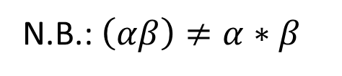
Two-way ANOVA: model
Assumptions!!
$$y_{{ij}_{k}}=μ+α_{i}+β_{j}+{\left(αβ\right)}_{ij}+ε_{{ij}_{k}};ε_{{ij}_{k}}\sim N\left(0,σ^{2}\right)$$
Mean
Main effect
factor A
Individual
Residual
Main effect
factor B
Interaction
factor (A,B)
N.B.: $\left(αβ\right)≠α∗β$

Slide 19
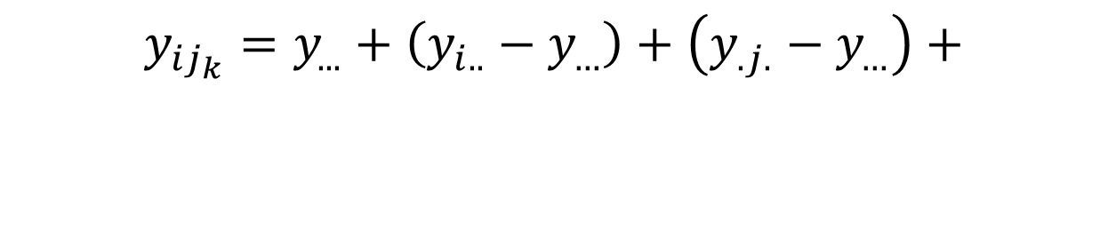
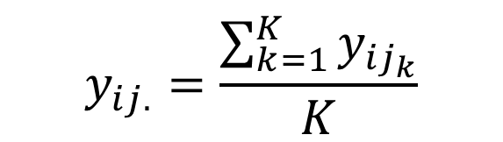
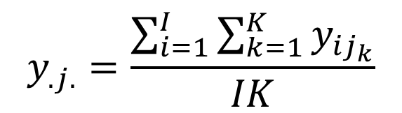
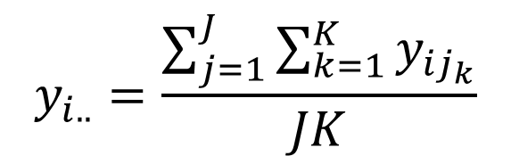
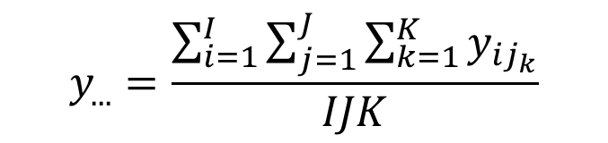
Two-way ANOVA: estimates
$$y_{...}=\frac{\sum_{i=1}^{I}{\sum_{j=1}^{J}{\sum_{k=1}^{K}{y_{{ij}_{k}}}}}}{IJK}$$
Mean
Main effect
factor A
Main effect
factor B
$$y_{i..}=\frac{\sum_{j=1}^{J}{\sum_{k=1}^{K}{y_{{ij}_{k}}}}}{JK}$$
$$y_{{ij}_{k}}=y_{...}+\left(y_{i..}−y_{…}\right)+\left(y_{.j.}−y_{…}\right)+$$
$$\left(y_{ij.}−y_{i..}−y_{.j.}+y_{...}\right)+\left(y_{{ij}_{k}}−y_{ij.}\right)$$
$$y_{.j.}=\frac{\sum_{i=1}^{I}{\sum_{k=1}^{K}{y_{{ij}_{k}}}}}{IK}$$
Interaction
factor (A,B)
Individual
Residual
$$y_{ij.}=\frac{\sum_{k=1}^{K}{y_{{ij}_{k}}}}{K}$$
Notes:
2 replicates: 18.5 and 19.5
19.5 = mean + A + B + Int + res
Y = 10 + 3 + 5 + 1 + 0.5
Mean = 10
Main A = 13 – 10 = 3
Main B = 15 – 10 = 5
Int = 19 – 13 – 15 + 10 = 1
Res = 19.5 – 19 = 0.5

Slide 20
Two-way ANOVA: sums of squares
Sum of squares similar to One-Way ANOVA:
Cross-products are 0 because of orthogonality of the design
Linear additivity!

Slide 21
Typical designs in omics studies: Two-way Crossed Design
Design Factors
Y-mean = Y_{time} + Y_{treatment} + Y_{interaction} + E
Time
treatment
interaction
Tyrosine
Tyrosine
Tyrosine
Tyrosine
Sample | Time | Treat ment
1 | 1 | 1
2 | 1 | 1
3 | 1 | 2
4 | 1 | 2
5 | 1 | 3
6 | 1 | 3
7 | 2 | 1
8 | 2 | 1
9 | 2 | 2
10 | 2 | 2
11 | 2 | 3
12 | 2 | 3
13 | 3 | 1
14 | 3 | 1
15 | 3 | 2
16 | 3 | 2
17 | 3 | 3
18 | 3 | 3
19 | 4 | 1
20 | 4 | 1
21 | 4 | 2
22 | 4 | 2
23 | 4 | 3
24 | 4 | 3
Tyrosine
-0.3966
-0.3879
-0.2193
-0.0334
0.1903
0.3952
-0.4892
-0.3101
-0.0788
0.3941
-0.1609
1.7989
-0.4608
-0.6839
-0.0912
-0.1951
0.1603
-0.031
-0.5412
-0.4916
0.0237
-0.247
1.7142
0.1413
Time
-0.0753
-0.0753
-0.0753
-0.0753
-0.0753
-0.0753
0.1923
0.1923
0.1923
0.1923
0.1923
0.1923
-0.2169
-0.2169
-0.2169
-0.2169
-0.2169
-0.2169
0.0999
0.0999
0.0999
0.0999
0.0999
0.0999
Treatment
-0.4702
-0.4702
-0.0559
-0.0559
0.526
0.526
-0.4702
-0.4702
-0.0559
-0.0559
0.526
0.526
-0.4702
-0.4702
-0.0559
-0.0559
0.526
0.526
-0.4702
-0.4702
-0.0559
-0.0559
0.526
0.526
Time treatment interaction
Residual
1
1
2
2
3
3
1
1
2
2
3
3
1
1
2
2
3
3
1
1
2
2
3
3
0.153
0.153
0.005
0.005
-0.158
-0.158
-0.122
-0.122
0.021
0.021
0.101
0.101
0.115
0.115
0.130
0.130
-0.244
-0.244
-0.146
-0.146
-0.156
-0.156
0.302
0.302
-0.005
0.005
-0.093
0.093
-0.102
0.102
-0.089
0.089
-0.236
0.236
-0.980
0.980
0.112
-0.112
0.052
-0.052
0.096
-0.096
-0.025
0.025
0.135
-0.135
0.786
-0.786
=
+
+
+
Sum of squares
8.6169
0.5984
4.008
0.6002
3.4100

Slide 22
Decomposition into effect matrices for all variables
$$y_{jki_{jk}}− μ = α_{j} + β_{k} + {αβ}_{jk} +{ e}_{jki_{jk}}$$
Design Factors
$$Y − Y_{intercept} = Y_{treatment} + Y_{time} + { Y}_{time:treatment} + E$$
Time
treatment
interaction
Sample | Time | Treat ment
1 | 1 | 1
2 | 1 | 1
3 | 1 | 2
4 | 1 | 2
5 | 1 | 3
6 | 1 | 3
7 | 2 | 1
8 | 2 | 1
9 | 2 | 2
10 | 2 | 2
11 | 2 | 3
12 | 2 | 3
13 | 3 | 1
14 | 3 | 1
15 | 3 | 2
16 | 3 | 2
17 | 3 | 3
18 | 3 | 3
19 | 4 | 1
20 | 4 | 1
21 | 4 | 2
22 | 4 | 2
23 | 4 | 3
24 | 4 | 3
Tyrosine Lysine
Tyrosine Lysine
Tyrosine Lysine
Tyrosine Lysine
Tyrosine | Lysine
-0.3966 | -0.2017
-0.3879 | -0.4718
-0.2193 | 0.3284
-0.0334 | 0.1096
0.1903 | 0.4425
0.3952 | 0.8862
-0.4892 | -0.7128
-0.3101 | -0.3931
-0.0788 | 0.3619
0.3941 | 0.3118
-0.1609 | 0.2076
1.7989 | 0.5966
-0.4608 | -0.6939
-0.6839 | -0.7274
-0.0912 | -0.516
-0.1951 | -0.4889
0.1603 | 1.0772
-0.031 | 0.7402
-0.5412 | -0.7148
-0.4916 | -0.5382
0.0237 | -0.3661
-0.247 | -0.4446
1.7142 | 0.1468
0.1413 | 1.0603
Treatment | Treatment
-0.4702 | -0.5567
-0.4702 | -0.5567
-0.0559 | -0.088
-0.0559 | -0.088
0.526 | 0.6447
0.526 | 0.6447
-0.4702 | -0.5567
-0.4702 | -0.5567
-0.0559 | -0.088
-0.0559 | -0.088
0.526 | 0.6447
0.526 | 0.6447
-0.4702 | -0.5567
-0.4702 | -0.5567
-0.0559 | -0.088
-0.0559 | -0.088
0.526 | 0.6447
0.526 | 0.6447
-0.4702 | -0.5567
-0.4702 | -0.5567
-0.0559 | -0.088
-0.0559 | -0.088
0.526 | 0.6447
0.526 | 0.6447
Time treatment interaction
Individual residual
1
1
2
2
3
3
1
1
2
2
3
3
1
1
2
2
3
3
1
1
2
2
3
3
Time | Time
-0.0753 | 0.1822
-0.0753 | 0.1822
-0.0753 | 0.1822
-0.0753 | 0.1822
-0.0753 | 0.1822
-0.0753 | 0.1822
0.1923 | 0.062
0.1923 | 0.062
0.1923 | 0.062
0.1923 | 0.062
0.1923 | 0.062
0.1923 | 0.062
-0.2169 | -0.1015
-0.2169 | -0.1015
-0.2169 | -0.1015
-0.2169 | -0.1015
-0.2169 | -0.1015
-0.2169 | -0.1015
0.0999 | -0.1427
0.0999 | -0.1427
0.0999 | -0.1427
0.0999 | -0.1427
0.0999 | -0.1427
0.0999 | -0.1427
0.15
0.15
0.00
0.00
-0.15
-0.15
-0.12
-0.12
0.02
0.02
0.10
0.10
0.11
0.11
0.13
0.13
-0.24
-0.24
-0.15
-0.15
-0.15
-0.15
0.30
0.30
0.027
0.027
0.124
0.124
-0.162
-0.162
-0.068
-0.068
0.36
0.36
-0.30
-0.30
-0.06
-0.06
-0.313
-0.313
0.36
0.36
0.06
0.06
-0.17
-0.17
0.10
0.10
-0.004
0.004
-0.093
0.093
-0.102
0.102
-0.089
0.089
-0.236
0.236
-0.97
0.97
0.111
-0.111
0.051
-0.051
0.095
-0.095
-0.024
0.024
0.135
-0.135
0.786
-0.786
0.15
-0.15
0.11
-0.11
-0.22
0.22
-0.15
0.15
0.02
-0.02
-0.19
0.19
0.03
-0.03
-0.01
0.01
0.17
-0.17
-0.07
0.07
0.04
-0.04
-0.46
0.46
replicates
=
+
+
+
+
22
Notes:
Model for single response value
Model in whole matrices
If there are more than 1 response variables

Slide 23

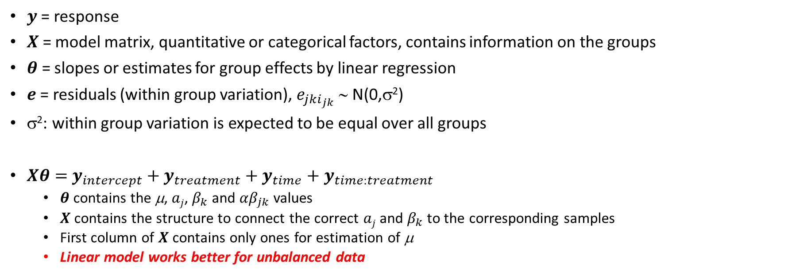
Linear model for 2-way ANOVA
$$y=Xθ+e$$
$$y =y_{intercept}+y_{treatment}+y_{time}+y_{time:treatment} +e$$
$y$= response
$X$ = model matrix, quantitative or categorical factors, contains information on the groups
$θ$ = slopes or estimates for group effects by linear regression
$e$= residuals (within group variation), $e_{jki_{jk}}$ ∼ N(0,σ²)
σ²: within group variation is expected to be equal over all groups
$Xθ=$ $y_{intercept}+y_{treatment}+y_{time}+y_{time:treatment}$
  $θ$ contains the μ, $aj$, $β_{k}$ and ${αβ}_{jk}$ values
  $X$ contains the structure to connect the correct $aj$ and $β_{k}$ to the corresponding samples
  First column of $X$ contains only ones for estimation of μ
  Linear model works better for unbalanced data
Thiel, Feraud and Govaerts, ASCA+, Journal of Chemometrics, 2017
23

Slide 24
X: Model matrices using different codings for categorical factors
Time | I | T1 | T2 | T3 | T4
1 | 1 | 1 | 0 | 0 | 0
2 | 1 | 0 | 1 | 0 | 0
3 | 1 | 0 | 0 | 1 | 0
4 | 1 | 0 | 0 | 0 | 1
y = y_{intercept} +y_{time} + y_{E} y_{time} = X_{time} * β_{time} + y_{E}
Time effect matrix y_{time} can be obtained by product of design matrix X_{time}* effect size (β _{time}) for each time point:
Dummy coding has closure (each row adds to 1), rank deficient
  Cannot be used in regression
  X_{time} = [T2 T3 T4]; combine indicator variables
  β_{time} for T1 depends on coding scheme
  Estimated effects have different meaning depending on coding used.
  Reference coding: 1 of the levels is chosen as reference.
  Sum coding compares all effects wrt overall mean (ASCA like)
 | Time
 | 1
 | 1
 | 1
 | 1
 | 1
 | 1
 | 2
 | 2
 | 2
 | 2
 | 2
 | 2
 | 3
 | 3
 | 3
 | 3
 | 3
 | 3
 | 4
 | 4
 | 4
 | 4
 | 4
 | 4
Dummy coding
Time | I | T2 | T3 | T4
1 (ref) | 1 | 0 | 0 | 0
2 | 1 | 1 | 0 | 0
3 | 1 | 0 | 1 | 0
4 | 1 | 0 | 0 | 1
Reference coding
Coding | β (T1) | β (T2) | β (T3) | β (T4)
Reference | 0 | Deviation from T1
Sum | 0 – (β_{T2} +β_{T3 +} β_{T4}) | Deviation from average timepoint
Time | I | T2 | T3 | T4
1 (ref) | 1 | -1 | -1 | -1
2 | 1 | 1 | 0 | 0
3 | 1 | 0 | 1 | 0
4 | 1 | 0 | 0 | 1
Sum coding
24
Notes:
Smaller example with on 4 timepoints
Dummy matrix
Intercept column estimated the average over all time points. Then there is redundant information in Dummy as if we now the average and only 3 of the 4 effects we also know the last.
This redundant information gives problems when estimating the effects.
Effect for time 1 is not calculated: defined as 0, or
Similar to contrast

Slide 25
Exercise:
y
Three treatments were applied, and 4 replicates were taken.
y_{ik} = μ + α_{i} + e_{ik}
Use linear model to estimate μ and α_{i}
  Make model matrix X_{r2} using reference coding, where treatment 2 is reference.
  Calculate μ and α_{1,} α_{2,} α₃
  Make model matrix X_{s2} using sum coding where treatment 2 gets the -1 values
  Calculate μ and α_{1,} α_{2,} α₃
Discuss the differences.
6
7
5
6
3
2
1
2
1
2
1
0
6
2
1
Notes:
Xr2 = [1 1 1 1 0 0 0 0 0 0 0 0; 0 0 0 0 0 0 0 0 1 1 1 1]’
Mu = 2 ( = treatment 2 average)
α1, = 4, α2 = 0, α3 = -1
Xs2 = [1 1 1 1 -1 -1 -1 -1 0 0 0 0; 0 0 0 0 -1 -1 -1 -1 1 1 1 1]’
Mu = mean = 3
α1, = 3, α2 = -1 (as effects should add up to 0), α3 = -2

Slide 26
y_{ik} = μ + α_{i} + e_{ik}
Xs₂
Xr₂
I
1
1
1
1
1
1
1
1
1
1
1
1
T1
1
1
1
1
-1
-1
-1
-1
0
0
0
0
T3
0
0
0
0
-1
-1
-1
-1
1
1
1
1
I
1
1
1
1
1
1
1
1
1
1
1
1
T1
1
1
1
1
0
0
0
0
0
0
0
0
T3
0
0
0
0
0
0
0
0
1
1
1
1
y
6
7
5
6
3
2
1
2
1
2
1
0
6
2
1
[μ, α_{1,} α₃] = (Xr₂^{T}Xr₂)⁻¹ Xr₂^{t}y
μ = 2 = level T2
α₁ = 4 = level 1 - μ
α₃ = -1 = level 3 - μ
α₂ = 0 = level 2 - μ
[μ, α_{1,} α₃] = (Xs₂^{T}Xs₂)⁻¹ Xs₂^{t}y
μ = mean of all values = 3
α₁ = 3 = level 1 - μ
α₃ = -2 = level 3 - μ
α₂ = 0 - α₃ - α₁ = -1

Slide 27
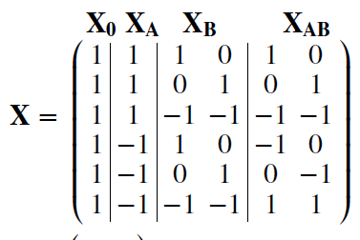
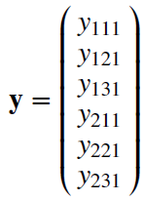
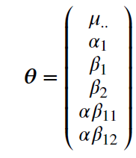



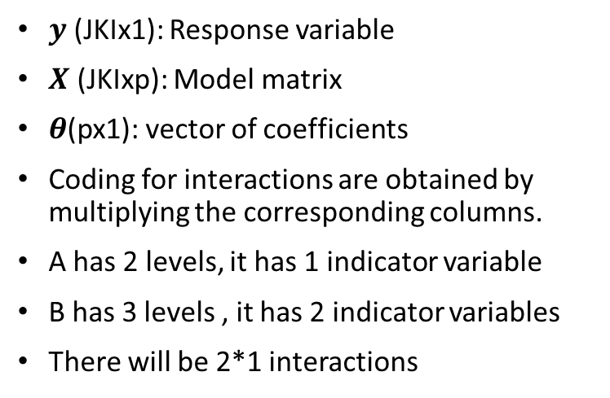
Linear model with two factors or Two-way ANOVA
$$y=Xθ+ε$$
$$θ={X^{t}X}^{−1}X^{t}y$$
$y$ (JKIx1): Response variable
$X$ (JKIxp): Model matrix
$θ$(px1): vector of coefficients
Coding for interactions are obtained by multiplying the corresponding columns.
A has 2 levels, it has 1 indicator variable
B has 3 levels , it has 2 indicator variables
There will be 2*1 interactions
X₀*μ + X_{A}*α₁ + X_{B}*[β₁ β₂] + X_{AB}*[αβ₁₁ αβ₁₂]
y = y₀ + y_{α} + y_{β} + y_{αβ} + $ε$
27
Notes:
Explain X for interaction
2 levels than only 1 indicator variable

Slide 28




Multi-response two-way ANOVA and effect matrices
One can apply the same model matrix for each measured variable $l$
$$y_{l}=Xθl+ε_{l}$$
$$y_{l}$$
$$θl$$
$$ε_{l}$$
y₁₁₁
y₁₂₁
y₁₃₁
y₂₁₁
y₂₂₁
y₂₃₁
y₁₁₂
y₁₂₂
y₁₃₂
y₂₁₂
y₂₂₂
y₂₃₂
μ
α1
β1
β2
αβ11
αβ12
μ
α1
β1
β2
αβ11
αβ12
e₁₁₁
e₁₂₁
e₁₃₁
e₂₁₁
e₂₂₁
e₂₃₁
e₁₁₂
e₁₂₂
e₁₃₂
e₂₁₂
e₂₂₂
e₂₃₂
X₀*[μ μ] + X_{A}*[α₁ α₁] + X_{B}*[[β₁ β₂]^{t} [β₁ β₂]^{t}]+ X_{AB} * [[αβ₁₁ αβ₁₂]^{t} [αβ₁₁ αβ₁₂]^{t}]
Y = M₀ + M_{α} + M_{β} + M_{αβ} + $E$
28
Notes:
For multiple responses, X does not change, only theta gets additional columns for each variable

Slide 29
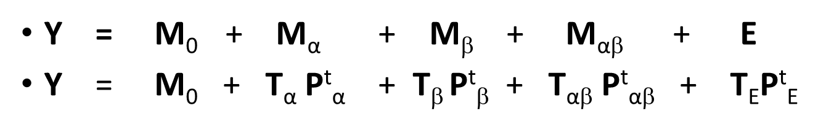
ASCA+ = Linear Model + PCA
Y = M₀ + M_{α} + M_{β} + M_{αβ} + E
Y = M₀ + T_{α} P^{t}_{α} + T_{β} P^{t}_{β} + T_{αβ} P^{t}_{αβ} + T_{E}P^{t}_{E}
PCA analysis
Y = M₀ + T_{β} P^{t}_{β} + T _{α+αβ} P^{t} _{α+αβ} + T_{E}P^{t}_{E}
Combination effect: M _{α} + M _{αβ} = T_{α+αβ} P^{t} _{α+αβ} : PCA on sum of M _{α} + M _{αβ}
ASCA+ can better deal with unbalanced groups or missing groups than ASCA
PCA of separate effect matrices to explore main factors
interactions are usually combined with a main effect as interactions represent differences
For each effect matrix an optimal number of components can be calculated
PCA can also be applied to E.
Thiel, Feraud and Govaerts., Journal of Chemometrics, 2017
29
Notes:
Ref to thiel

Slide 30
Validation(1): Show within level Variability using back-projections
Project effect matrix (M_{k}) + Residual (E) onto corresponding P_{k}:
$$Z_{k}=\left(M_{k}+E\right)P_{k}=T_{k}+EP_{k};k∈\{α,β,αβ\}$$
Plot rows of Z_{k}:

Slide 31
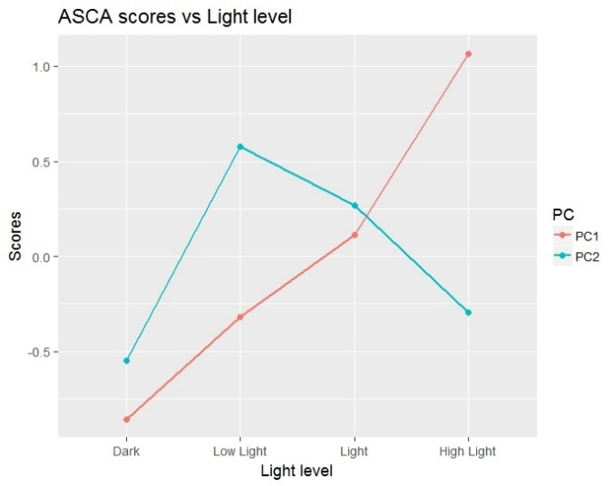
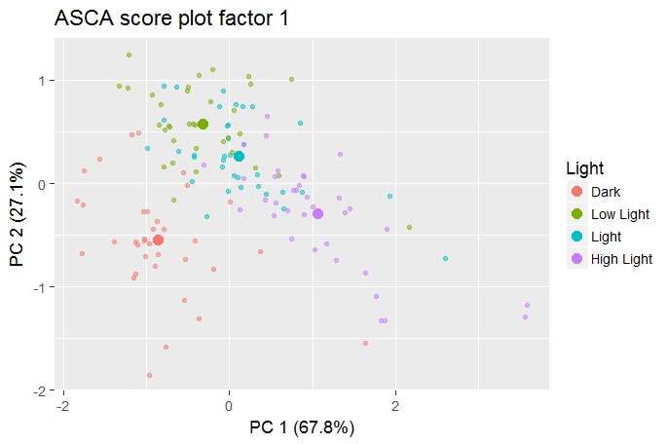
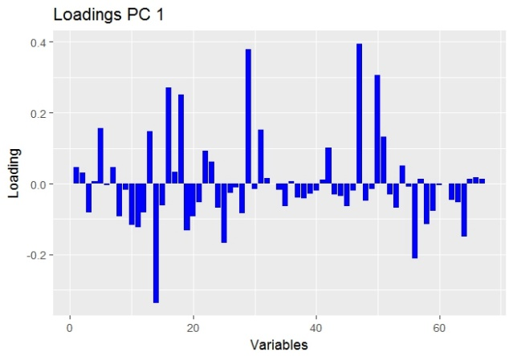
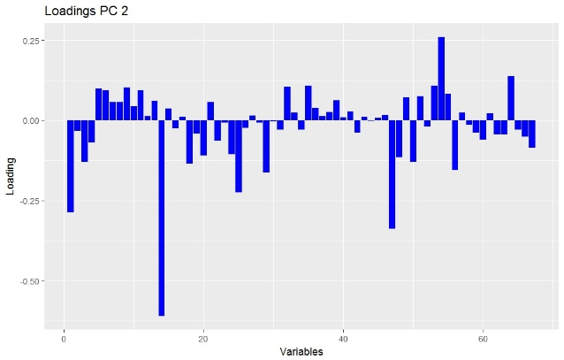
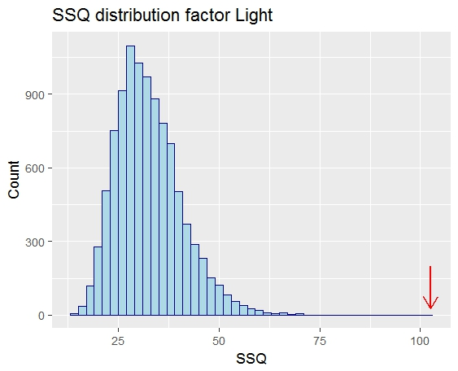
Caldana Plant example: ASCA of light effect
Scores with back-projections
PC1,2 vs light levels
PC1 vs PC2
PC1: linear Increasing effect
PC2: sudden effect after first light that decreases with more light
Notes:
Different ways to plot scores and loadings

Slide 32
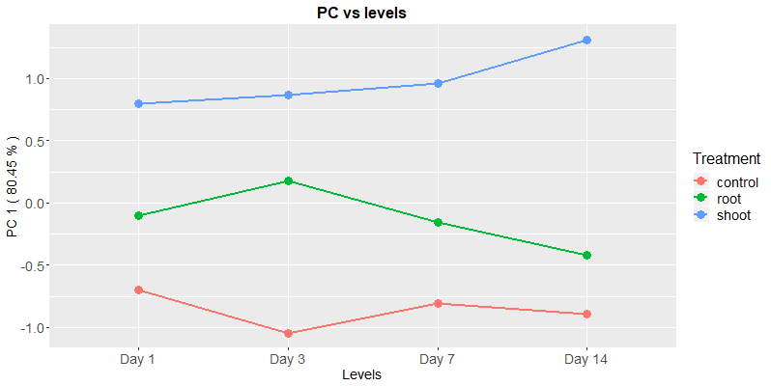
Example 2 ASCA: Combination of main and interaction effects
Plants measured at days 1,3,7,14 days after three (control, root, shoot) different treatments. Two replicates per design setting.
How do multivariate time profiles vary between treatments ?
PCA: multivariate analysis
Tyrosine Lysine
Tyrosine Lysine
Treatment | Treatment
-0.4702 | -0.5567
-0.4702 | -0.5567
-0.0559 | -0.088
-0.0559 | -0.088
0.526 | 0.6447
0.526 | 0.6447
-0.4702 | -0.5567
-0.4702 | -0.5567
-0.0559 | -0.088
-0.0559 | -0.088
0.526 | 0.6447
0.526 | 0.6447
-0.4702 | -0.5567
-0.4702 | -0.5567
-0.0559 | -0.088
-0.0559 | -0.088
0.526 | 0.6447
0.526 | 0.6447
-0.4702 | -0.5567
-0.4702 | -0.5567
-0.0559 | -0.088
-0.0559 | -0.088
0.526 | 0.6447
0.526 | 0.6447
Time treatment interaction
0.15
0.15
0.00
0.00
-0.15
-0.15
-0.12
-0.12
0.02
0.02
0.10
0.10
0.11
0.11
0.13
0.13
-0.24
-0.24
-0.15
-0.15
-0.15
-0.15
0.30
0.30
0.027
0.027
0.124
0.124
-0.162
-0.162
-0.068
-0.068
0.36
0.36
-0.30
-0.30
-0.06
-0.06
-0.313
-0.313
0.36
0.36
0.06
0.06
-0.17
-0.17
0.10
0.10
$$Y−Y_{intercept}=Y_{time}+Y_{treatment}+{ Y}_{time:treatment} + E$$
Scores PC1
Loadings PC1
+
Metabolites
Notes:
Notation As a data matrix
Combination (interaction is a difference)
Effect of treatment deviates over time due to interaction

Slide 33
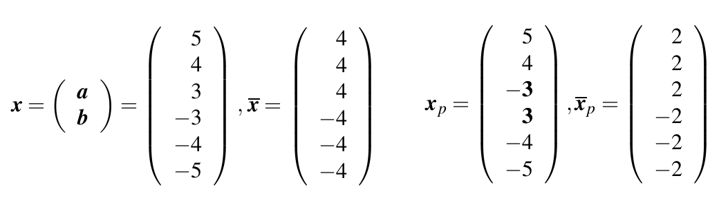

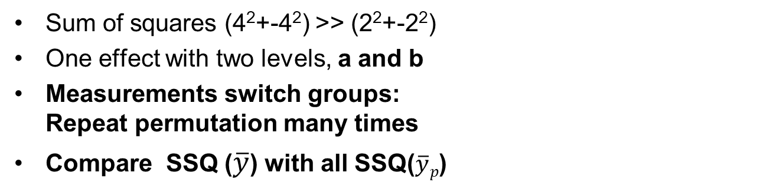



Permutation tests
$$y$$
$$\overline{y}$$
$$y_{p}$$
$$\overline{yp}$$
If H0 is true:
there is no difference between treatments a and b
All values come from same distribution
Permuting samples over groups would make no difference.
Sum of squares (4²+-4²) >> (2²+-2²)
One effect with two levels, a and b
Measurements switch groups:
Repeat permutation many times
Compare SSQ ($\overline{y}$) with all SSQ($\overline{y}p$)
Permutation test:
Randomly permute samples over treatments
Calculate effect is any way
Repeat many times
Compare original effect with all permuted effects

Slide 34
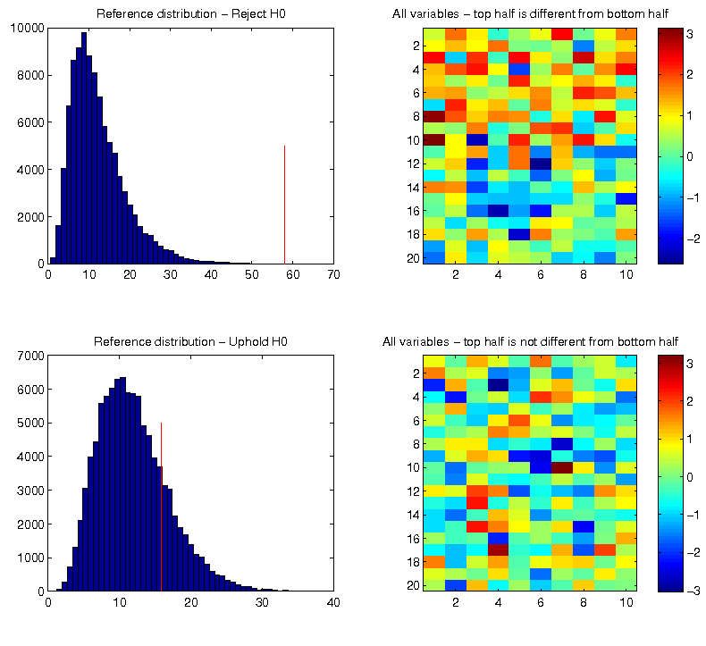
Multivariate permutations
Higher average
Different
Lower average
Equal average
Equal
Equal average

Slide 35
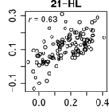
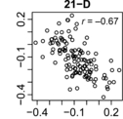
Individual effects (Residuals)
Residual
Sample | Time | Treat ment
1 | 1 | 1
2 | 1 | 1
3 | 1 | 1
4 | 1 | 1
5 | 1 | 1
6 | 1 | 2
7 | 1 | 2
8 | 1 | 2
9 | 1 | 2
10 | 1 | 2
11 | 1 | 2
12 | 1 | 2
13 | 2 | 1
14 | 2 | 1
15 | 2 | 1
16 | 2 | 1
17 | 2 | 1
18 | 2 | 1
19 | 2 | 2
20 | 2 | 2
21 | 2 | 2
22 | 2 | 2
23 | 2 | 2
24 | 2 | 2
Tyrosine Lysine
0.74 -0.04
0.85 2.47
-0.97 -1.04
0.62 -0.08
0.46 -0.04
-1.71 -1.24
1.92 0.46
-3.73 -2.97
0.65 -0.22
-1.17 -2.47
2.36 3.55
-0.04 1.66
0.58 -1.39
-0.02 -0.13
0.55 1.31
-1.36 0.09
-0.32 -0.12
0.57 0.25
2.19 -1.02
-1.67 1.45
1.05 -1.13
-0.05 -0.65
-1.01 0.29
-0.51 1.05
Effect matrices (main effect / interactions) show effects of different levels at factors.
Individual effects show individual variation within a certain design point.
Study correlations between variables at each design point separately.
PCA on individual effect to study systematic deviation over multiple variables.
  Outlying individuals can have systematic (same variables) deviations.
MASCARA: Multivariate ASCA-Residual Analysis
Shikimic acid
phenylalanine
Caldana et al, Plant Journal 2011
35
Notes:
Residuals can show trends not modelled for
2 factors, 6 replicates

Slide 36
Testing goals
Understand ANOVA, Linear models
What is the advantage of Linear model over ANOVA?
How can you validate an ASCA result!
Why border about ASCA residuals?

